Slide 1
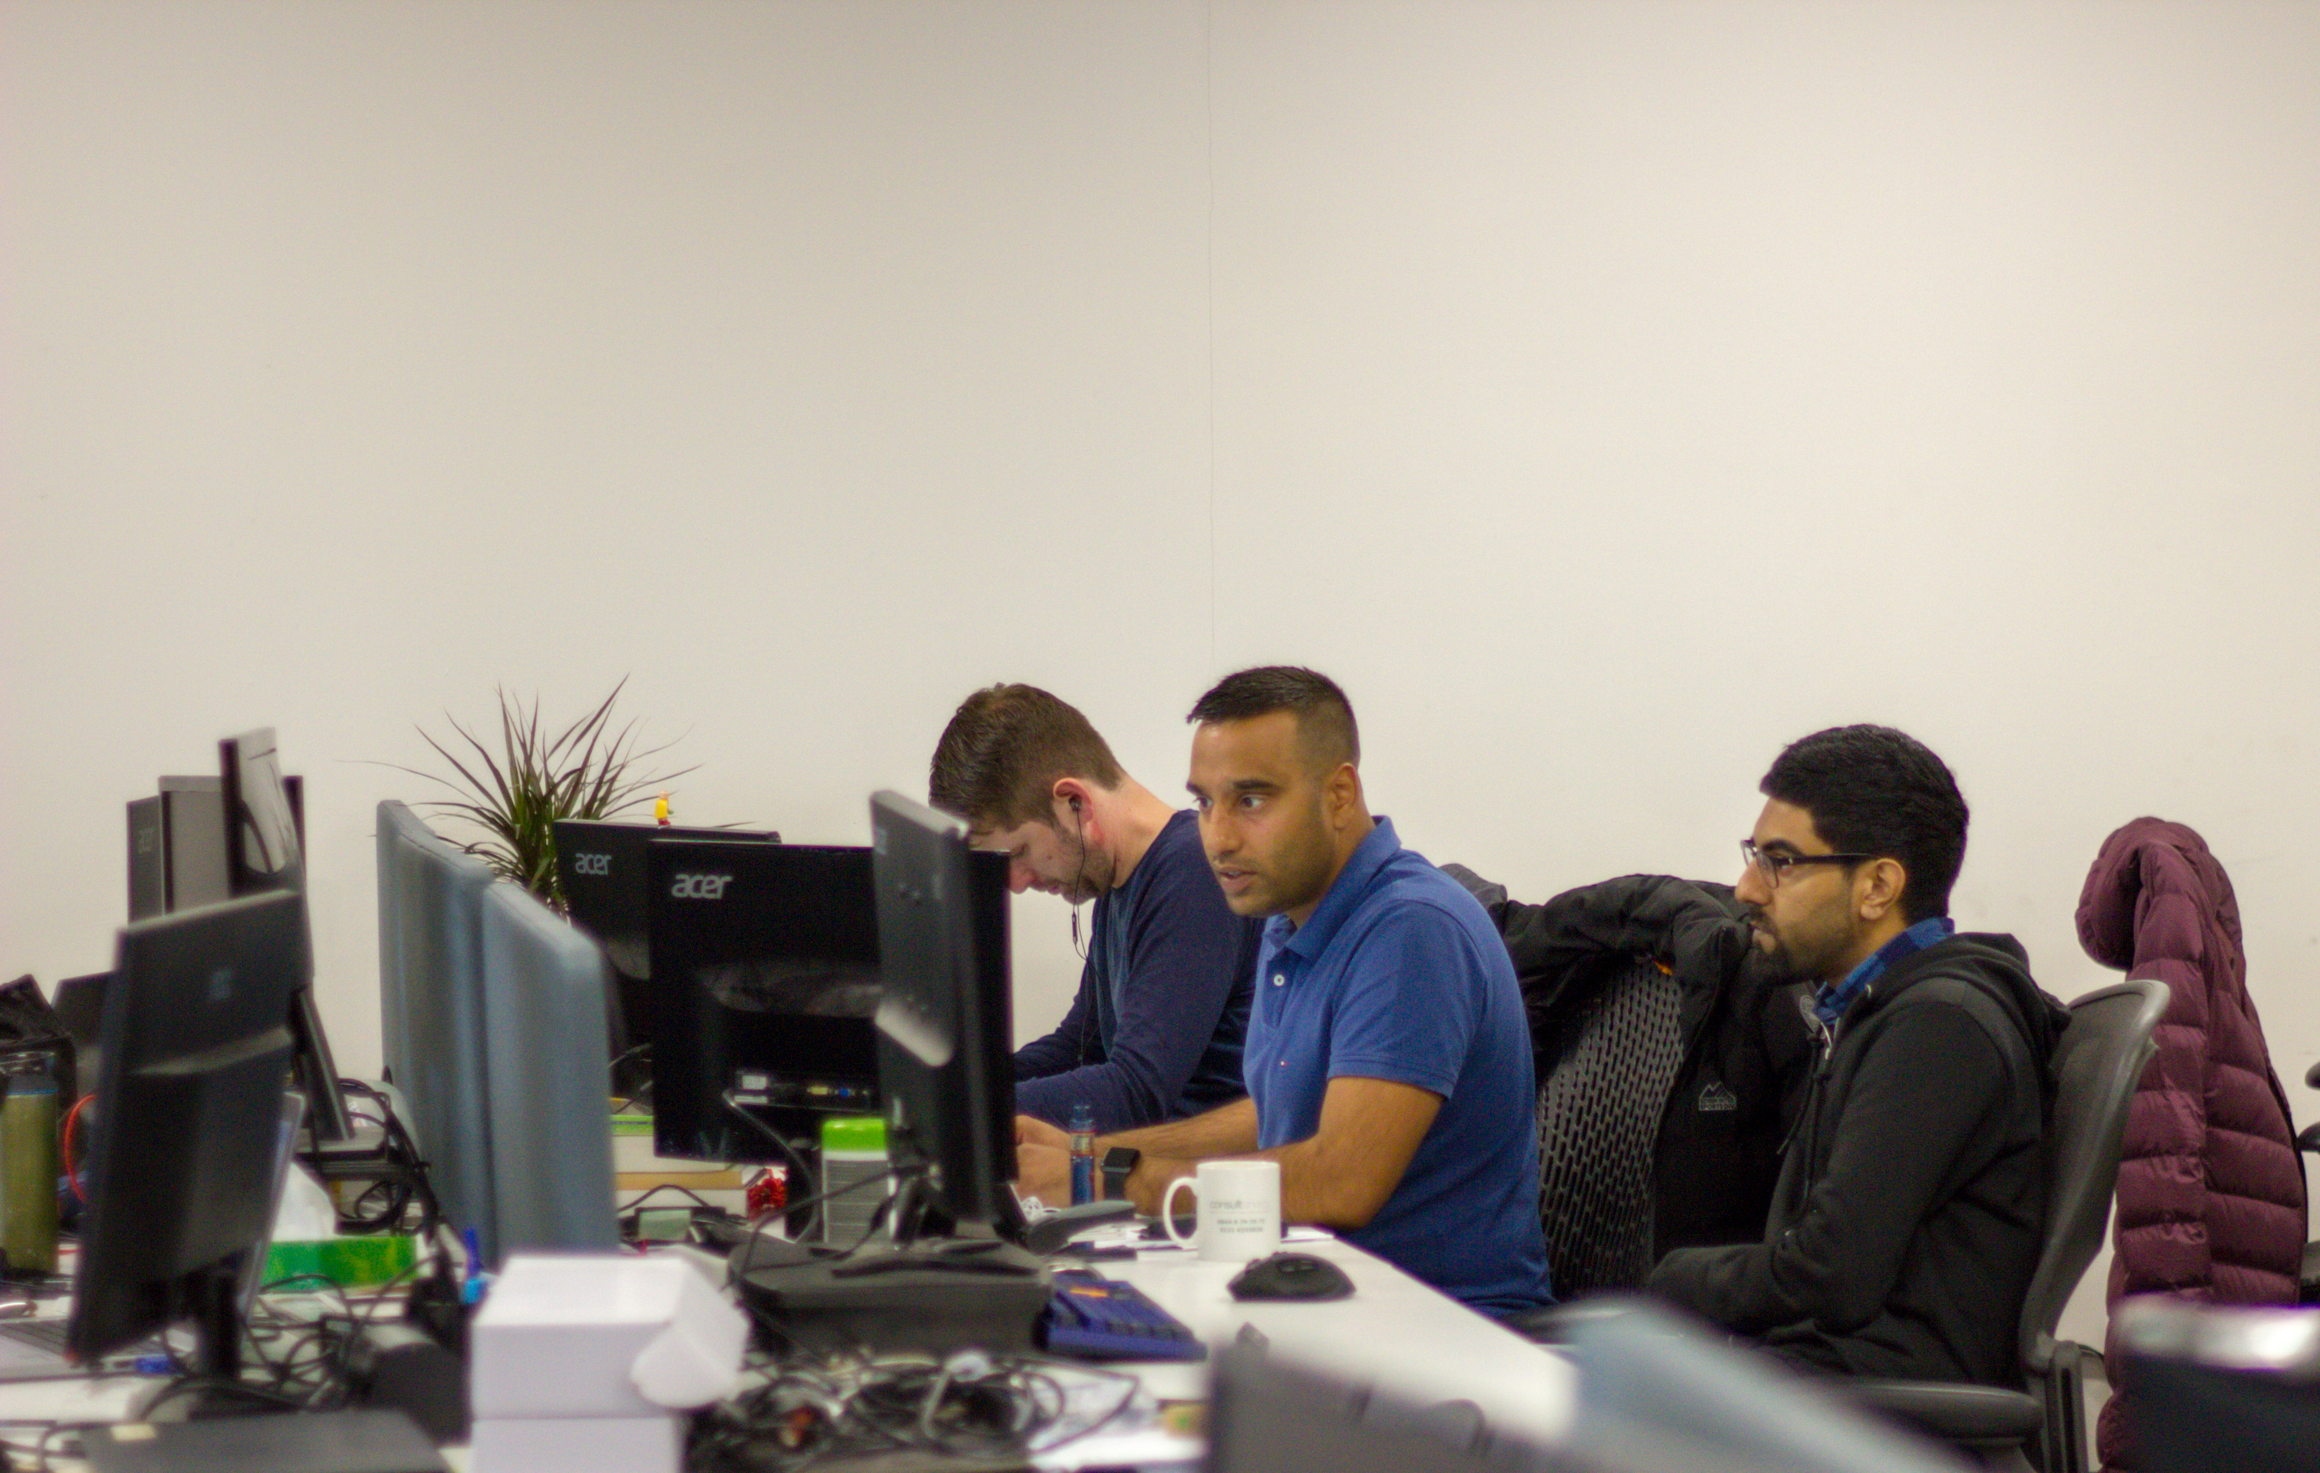
ENSEK REMOTE TECHNICAL TEST
Thanks for agreeing to do our remote technical test
The brief, plus two data files should be included in your pack
We hope you enjoy it. Good Luck
Notes:
Terminology point : We will call them ‘CHECK INS’. Aka 1:1’s, catch ups, touch points. 60 min session.

Slide 2
01
TASK
ENSEK REMOTE TECHNICAL TEST
Ensuring the Acceptance Criteria are met, build a C# Web API that connects to an instance of a database and persists the contents of the Meter Reading CSV file.
We have provided you with a list of test customers along with their respective Account IDs (please refer to Test_Accounts.csv). Please seed the Test_Accounts.csv data into your chosen data storage technology and validate the Meter Read data against the accounts.
From the day you receive this test, you have 48 hours to submit your work for assessment.
Please return to the hiring manager or as instructed otherwise. It is advised to use a publicly accessible Git repository to commit and share your work with us. Any work committed after the deadline won’t be considered towards the technical assessment.
1
Of 2

Slide 3
02
USER STORY
REMOTE TECHNICAL TEST
ENSEK REMOTE TECHNICAL TEST
As an Energy Company Account Manager, I want to be able to load a CSV file of Customer Meter Readings so that we can monitor their energy consumption and charge them accordingly

Slide 4
ENSEK REMOTE TECHNICAL TEST
03
ACCEPTANCE CRITERIA
MUST HAVE
Create the following endpoint:
POST => /meter-reading-uploads
The endpoint should be able to process a CSV of meter readings. An example CSV file has been provided (Meter_reading.csv)
Each entry in the CSV should be validated and if valid, stored in a DB.
After processing, the number of successful/failed readings should be returned.
Validation:
You should not be able to load the same entry twice
A meter reading must be associated with an Account ID to be deemed valid
Reading values should be in the format NNNNN
NICE TO HAVE
Create a client in the technology of your choosing to consume the API. You can use angular/react/whatever you like
When an account has an existing read, ensure the new read isn’t older than the existing read

Slide 5

ENSEK REMOTE TECHNICAL TEST
04
ATTACHED MATERIALS
Meter_reading.csv (test file for uploading meter readings)
Test_accounts.csv (use this to seed your db)

Slide 6
ENSEK REMOTE TECHNICAL TEST
05
NEXT STEPS
After submitting your solution you’ll be invited to a final stage interview where you’ll be asked to present the solution you’ve created and discuss it. The purpose of this discussion is to help us understand how you went about designing the solution, design choices, testing etc
Please make sure you have an appropriate way of presenting your solution (usually this is done via a screenshare + IDE)

Slide 7
ENSEK REMOTE TECHNICAL TEST
06
FINAL STAGE INTERVIEW SCHEDULE
The final stage interview will last around 1 hour, but please allow for up to 1.5 hours
The format of the interview will be as follows
A brief introduction
20 minutes talking about your approach to the technical test
20 minutes of competency based questions
20 minutes of questions for any questions you have

